Slide 1
BDD: behavior driven testing
45426: Teste e Qualidade de Software
Ilídio Oliveira
v2025-03-11

Slide 2
Learning objectives
Explain how “features/user-stories” are used as a conversation tool to build functional specifications
Write simple acceptance criteria for a user story in structured text
Write acceptance scenarios using the Gerking language
Describe the steps to implement BDD in Java using the Cucumber framework

Slide 3
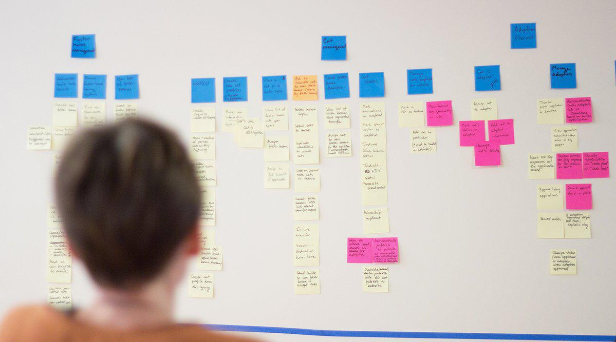
“post-it” & borads metaphor
The right granularity to distribute the work
Traceability to requirements (usage scenarios)
A few “post-it notes” per iteration

Slide 4
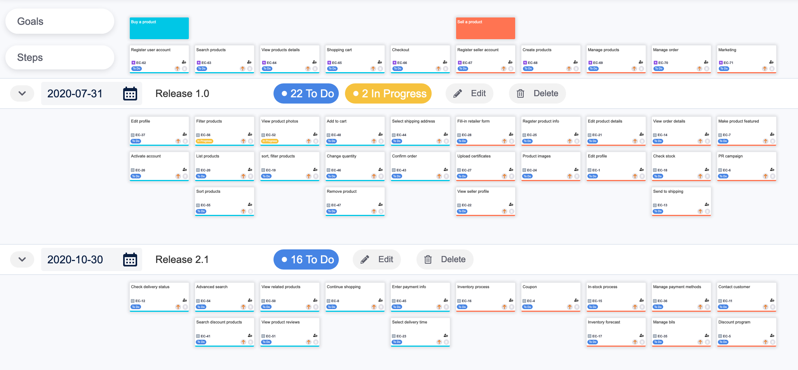

https://www.devsamurai.com/en/agile-user-story-mapping-for-jira/

Slide 5
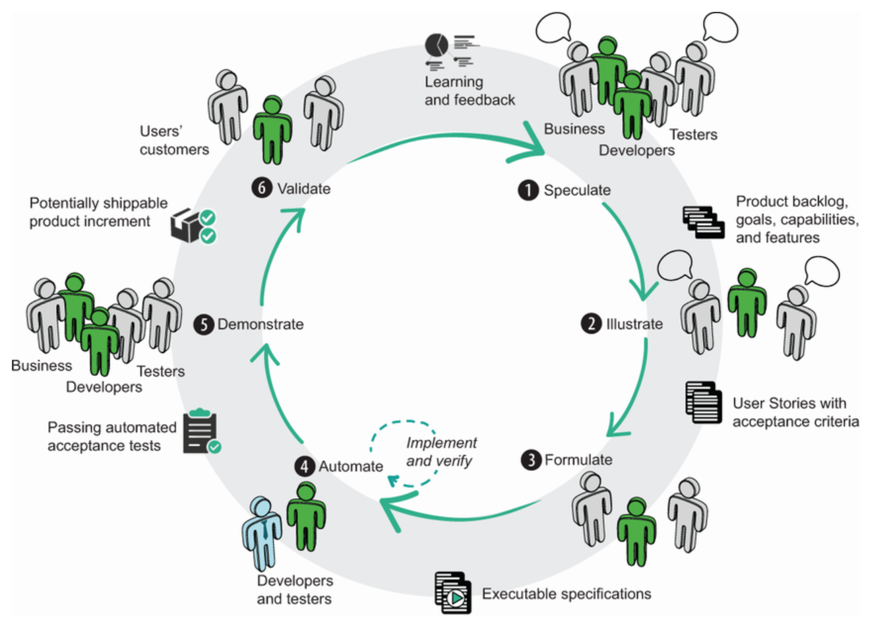
Activities in BDD team

Slide 6
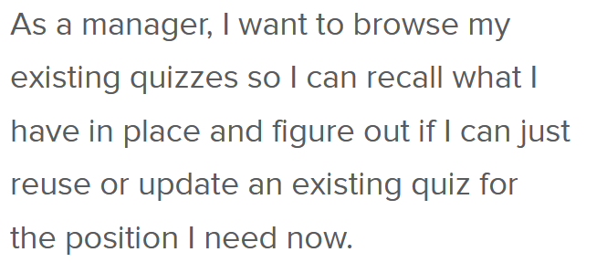
User stories: behavior by example
→ some examples

Slide 7
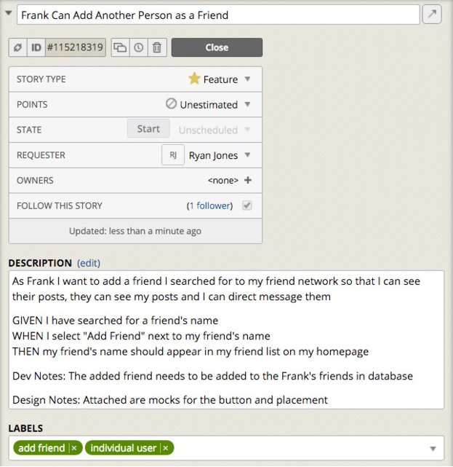
Stories and scenarios
(User) Story as the basic unit of functionality, and therefore of delivery.
  Captures a feature of the system
  defines the scope of the feature and its acceptance criteria.
They are also used as the basis for estimation when we come to do our planning
  Can be mapped on outcomes, requirements
https://www.pivotaltracker.com/blog/principles-of-effective-story-writing-the-pivotal-labs-way
What's in a Story?
http://dannorth.net/whats-in-a-story/
Notes:
A way for telling that the story is acceptably implemented
May have still low-level defects in the code
It'll be doing what the programmers intend it to
It'll be doing what it is supposed to be doing

Slide 8
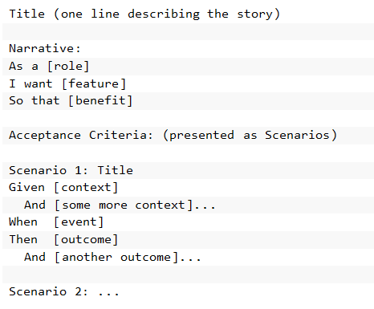
Stories and testing...
Can we write the acceptance criteria in a way that it is executable?

Slide 9
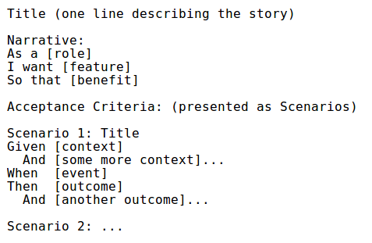
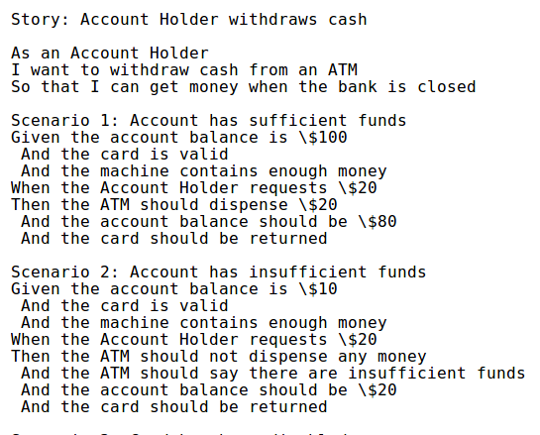








Story: the scope of a feature + its acceptance criteria.
Functional view.
Value for the user.
Specification by examples.
Credit: http://dannorth.net/whats-in-a-story/

Slide 10
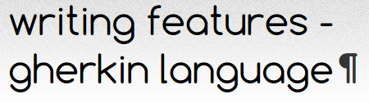
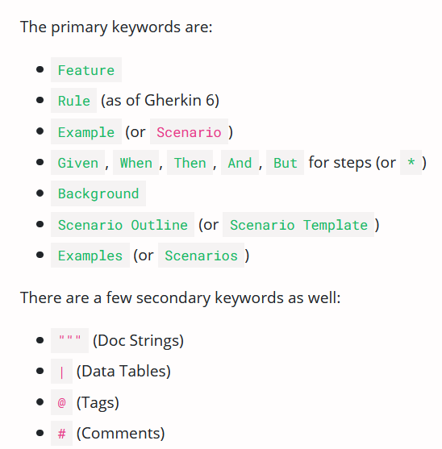
Features are described in the Gherkin Language (DSL)
Gherkin to describe a feature (for testing):
  Feature: what
  Scenario: some determinable business situation
  Given: preparation/setup (e.g.: required data)
    And…
  When: the set of actions (execute).
    And…
  Then: specifies the expected resulting state (assert).
    And…
→ Sample

Slide 11
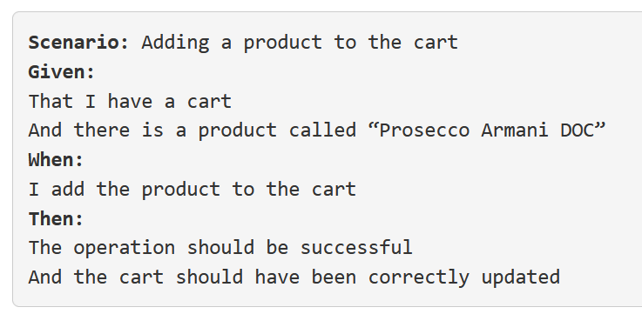
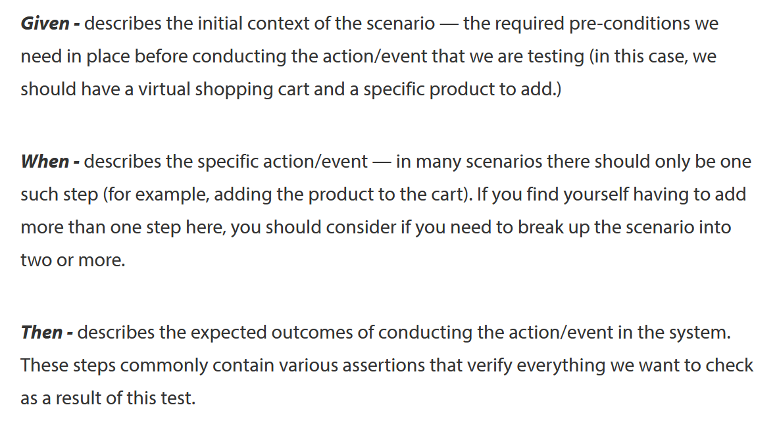

Slide 12
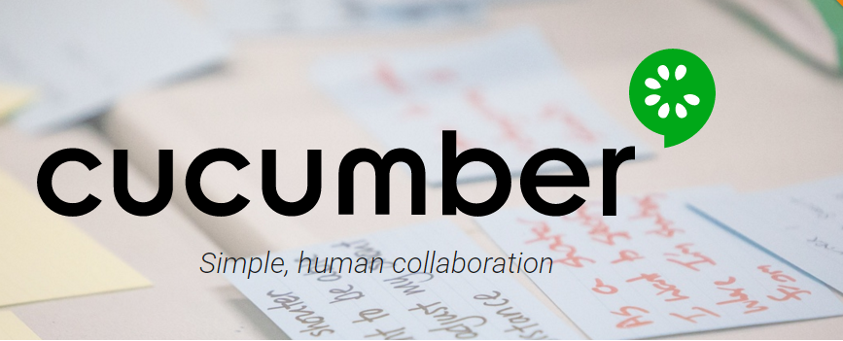
Cucumber framework for tests
Goal
  common understanding of the problem ⇒ simplify the communication between all parties
Cucumber way
  express requirements using concrete examples (Gherkin syntax)
  create examples of behavior that are executable
  examples are found in a collaborative way (business analysts, testers and developers)
  examples can be used as acceptance tests (with additional preparation steps)

Slide 13
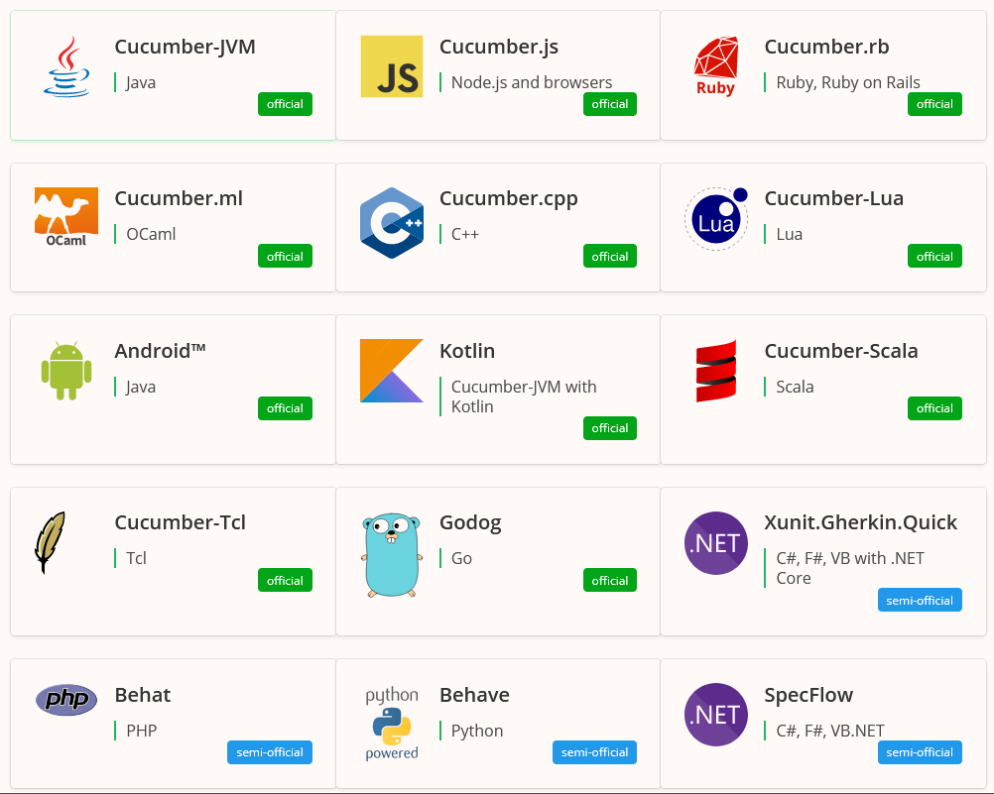
The same approach, many frameworks
https://cucumber.io/docs/installation/

Slide 14
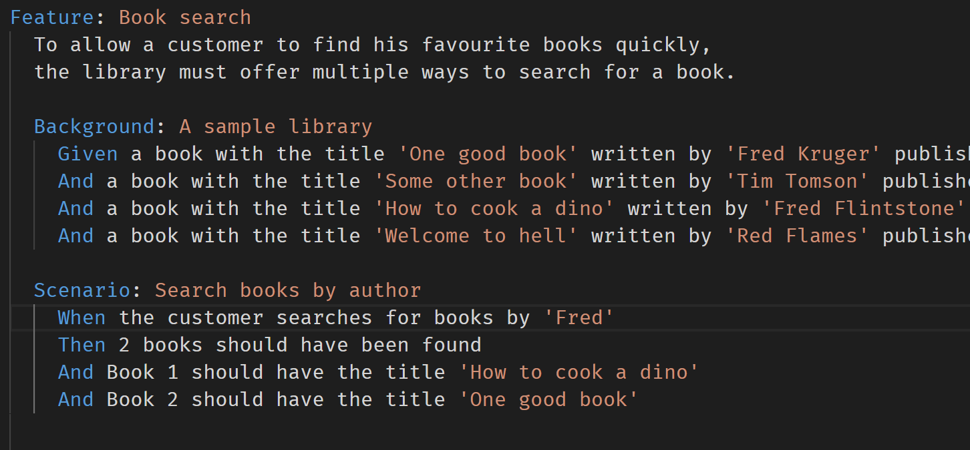
.feature

Slide 15
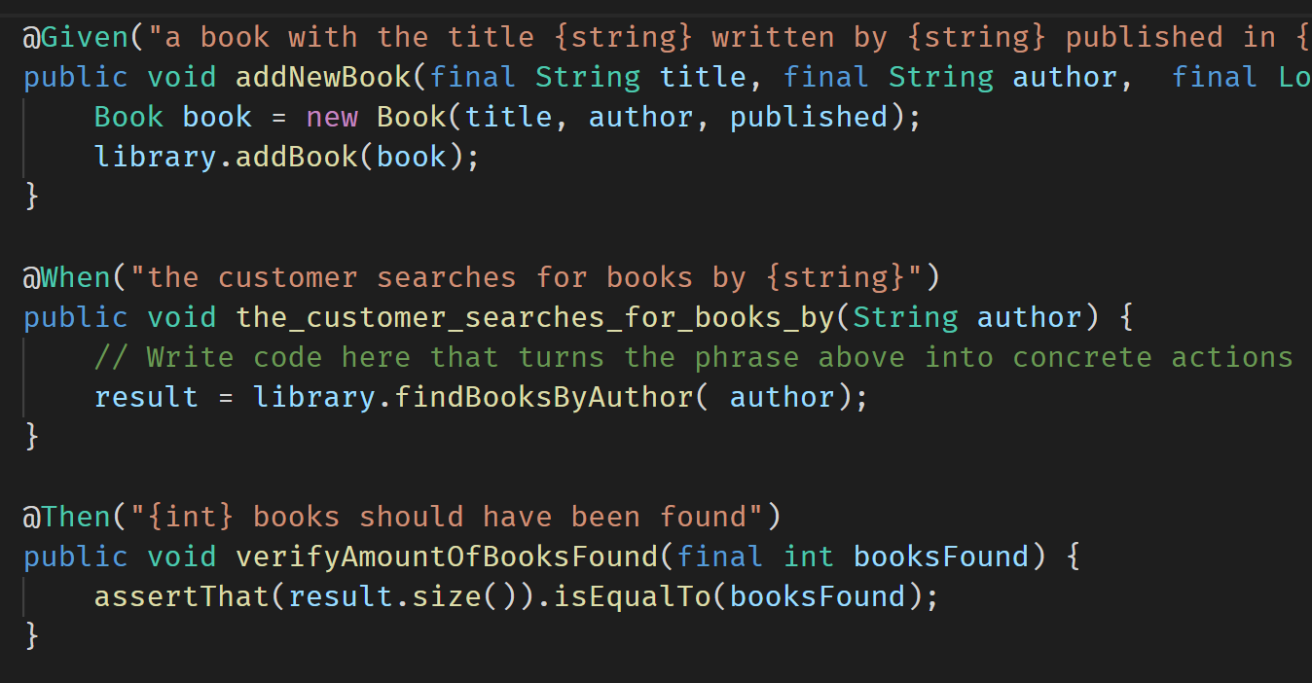
steps mapping
The steps in the feature are mapped to test methods, using annotations.

Slide 16
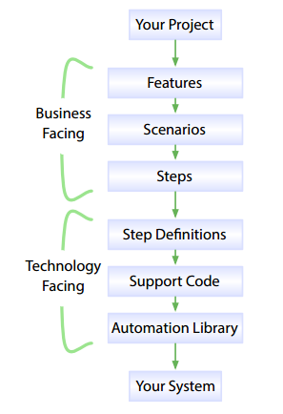
Cucumber reads specifications from plain-language text files called features, examines them for scenarios to test.
Each scenario is a list of steps for Cucumber to work through.
Along with the features, you give
Cucumber a set of step definitions, which map the business-readable language of each step into code to carry out whatever action is being described by the step.
The step definition itself will probably just be one or two lines of code that delegate to a library of support code, specific to the domain of your application.
Sometimes that may involve using an automation library, like the browser automation library Selenium.

Slide 17
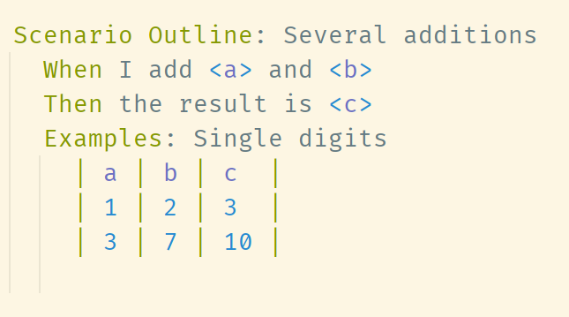
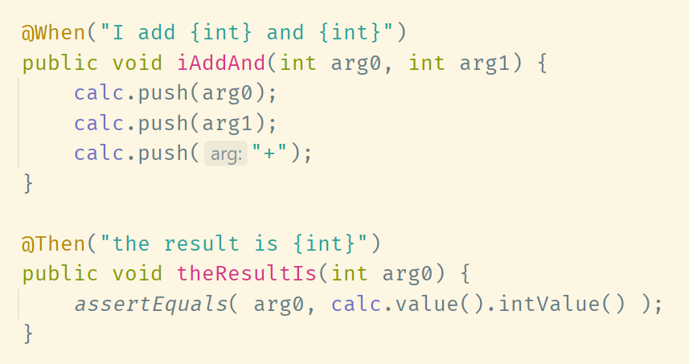
Helpful format: define an outline to be run against a few examples.

Slide 18
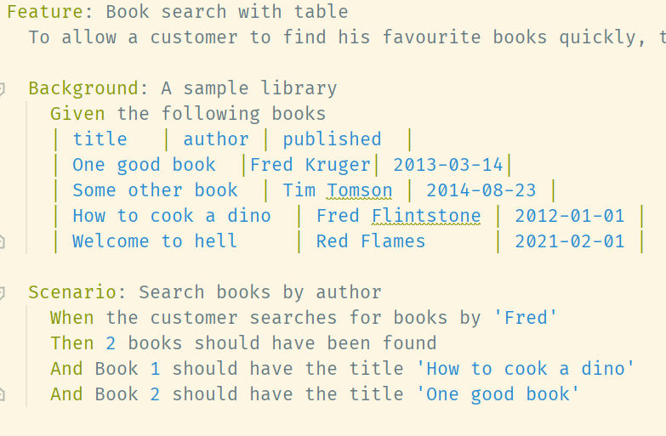
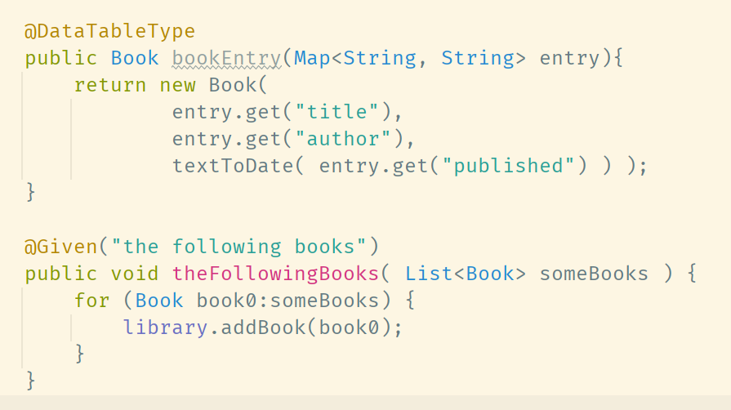
Specifications can include data as tables to feed the tests.

Slide 19
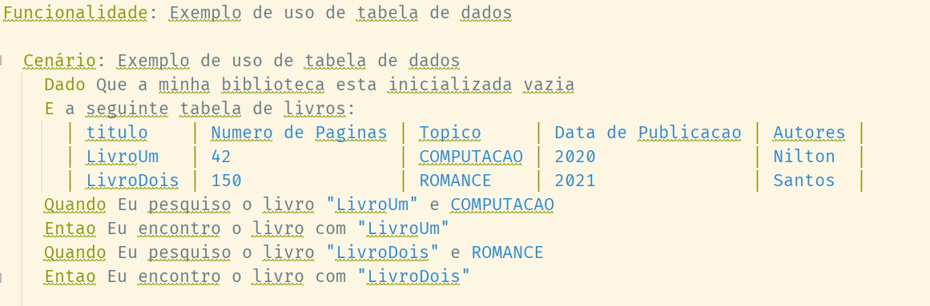
https://cucumber.io/docs/gherkin/languages/
Keywords available in different languages (localization)

Slide 20
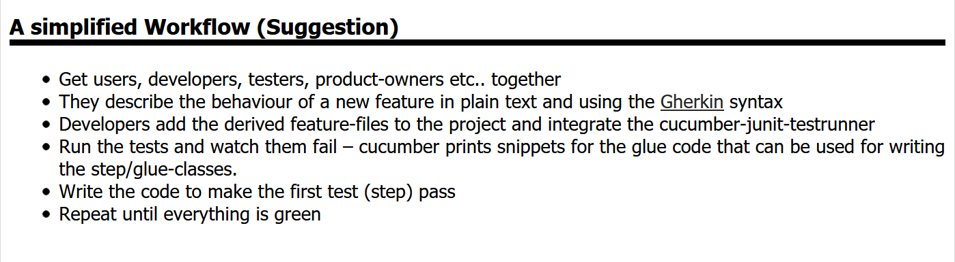
BDD as a work process

Slide 21
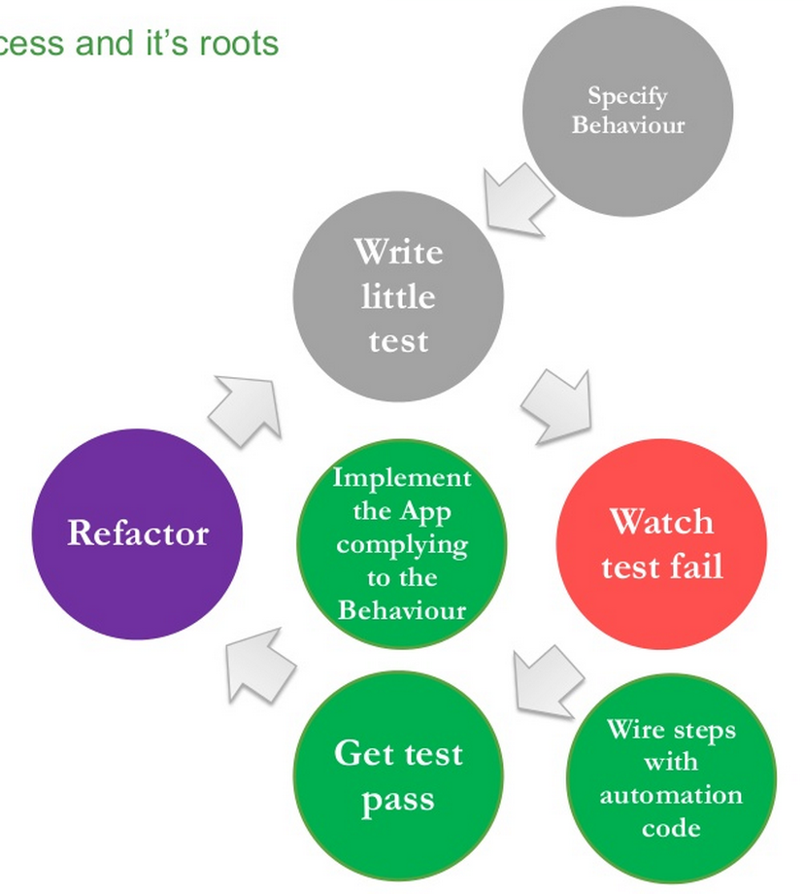
BDD: Behavior-driven
development
BDD is a test­-centric software development process that grew out of Test-­Driven Development (TDD). BDD focuses on clearly identifying the desired behavior of a feature from the very start.
Technical (e.g., developers) and non-technical (e.g., business analysts) participants in a software project collaborate to define a common understanding of expected behaviors.
Behaviors are identified using specification by example: behavior specs are written to illustrate the desired behavior with realistic examples. They serve as both the product’s requirements/acceptance criteria (before development) and its test cases (after development).
Gherkin is one of the most popular languages for writing formal behavior specifications. With automation tools, scenarios can be turned into automated test cases
Credit: Nalin Goonawardana

Slide 22
Activities in BDD team

Slide 23
Views from Robert C. Martin
  BDD is a variation on TDD.
  Whereas in TDD we drive the development of a module by “first” stating the requirements as unit tests, in BDD we drive that development by first stating the requirements as requirements.
  The form of those requirements is fairly rigid, allowing them to be interpreted by a tool that can execute them in a manner that is similar to unit tests.
https://sites.google.com/site/unclebobconsultingllc/the-truth-about-bdd

Slide 24
BDD vs TDD (xUnit Level)
BDD
TDD + Unit testing
Top-down
Human readable
  Sharable to all the team
Business-facing
  Tangible requirements.
Bottom-up
Programming language
  ☹
Developer-facing
  Module contracts.

Slide 25
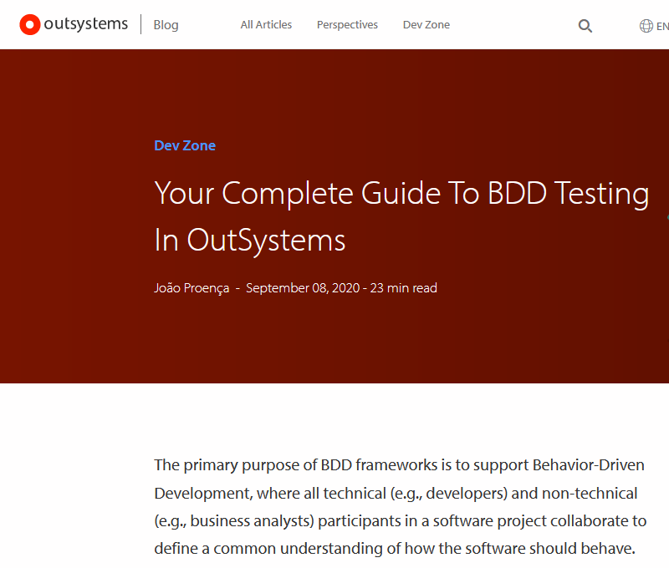
https://www.outsystems.com/blog/posts/bdd-testing/

Slide 26
Resources and readings
Sundberd, T., “Where should you use Behaviour Driven Development, BDD?”
https://smartbear.com/learn/automated-testing/is-bdd-right-for-you/
Kops, “BDD Testing with Cucumber, Java and Junit”

